Slide 1
Efficient Dynamic Skinning with Low-Rank Helper Bone Controllers
Tomohiko Mukai, Tokai University
Shigeru Kuriyama, Toyohashi University of Technology

Slide 2
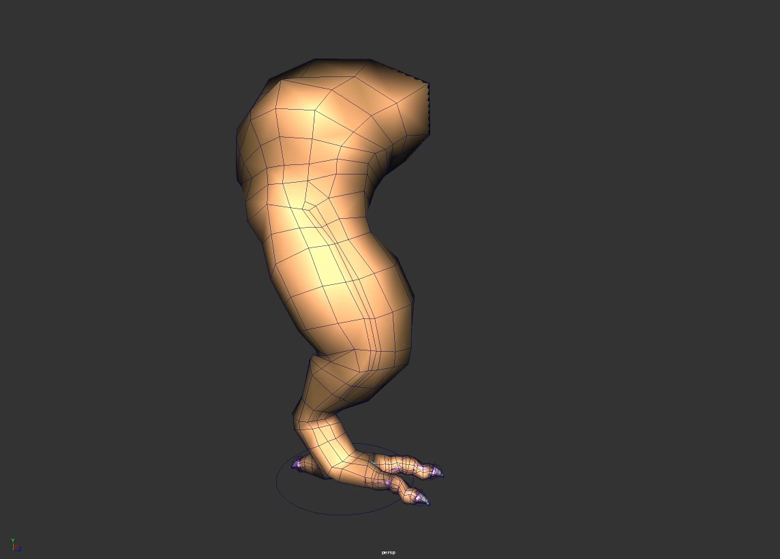
Motivation
Notes:
Expressive skin deformation is vital for believable character animation. Especially, dynamic skin behavior is important in visualizing how soft the model is. Our motivation is to develop a practical method for synthesizing dynamic skin deformation in real-time.

Slide 3
Wish List from Game Developers
[Hecker 2011]
Robustness
Simplicity
Compatibility with existing workflow
Performance
Fast & Predictable execution time
Small memory footprint
Quality
Physically-valid natural skin deformation
Plausible dynamic deformation
×Details (e.g. wrinkles) ×External forces (e.g. gravity) ×Physical validity
Notes:
There are several requirements in developing real-time technology. Ideally, we should maximize all of these, but it is very challenging. In this study, [CLICK] we slightly compromise the animation quality. Our method cannot provide detailed deformation, and does not guarantee the physical validity. Our goal is to provide plausible dynamic skin deformation with robust, simple and efficient computation.

Slide 4
Linear Blend Skinning (LBS)
[Thalmann 1988]
Robust
Simple
Supported by most engines
Established tools
High performance
Efficient & Predictable
Dynamic deformation
Notes:
The base technology of our method is linear blend skinning, or LBS. This is the de facto standard method that satisfies practical requirements except for dynamic deformations. Our method generates the dynamic behavior based on LBS while maintaining its simplicity and efficiency.

Slide 5
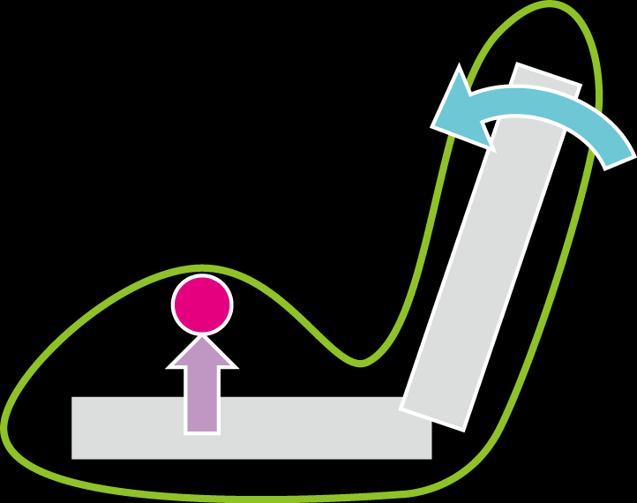
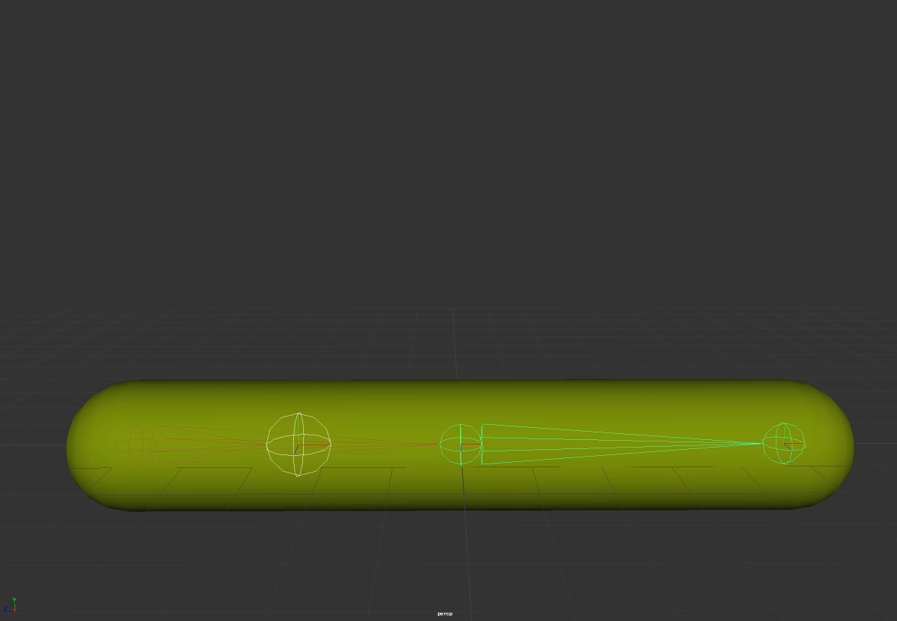
Helper Bone Rig
[Mohr 2003, Parks 2005, Kim 2011]
Primary bone
Helper bone
LBS
on GPU
Procedural control on CPU
（e.g. driven-key/expression in Maya）
Notes:
Our basic idea is to dynamically control helper bones. This extra bone drives the skin deformation together with primary bones via LBS. Its movement is procedurally controlled according to the movement of primary skeleton. This technique is widely used in real-time applications for correcting artifacts such as joint collapse. The helper bone is also used for creating stylized deformation such as muscle bulging as shown here. However, manual design is sometimes challenging. For instance, trial and error is required in writing scripts or expressions of the procedural controller. It’s also tedious to manually specify the skinning weights.

Slide 6
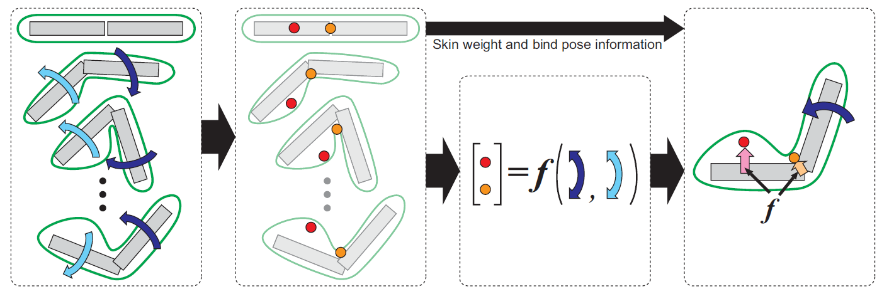
Example-based Helper Bone Control
Example skin
& skeleton
animation
Skin weights
& Helper bone
transformation
・ State-space model
・ System identification
・ Nuclear norm optimization
Notes:
In this study, we propose an example-based method for building dynamic helper bone rig. Our example data is a set of skin and skeleton animations. We first estimates the optimal skinning weights and helper bone transformations at each time frame, for best approximating the example skin shape. The helper bone controller is then constructed by learning a mapping from skeleton motion to the estimated helper bone transformations. Our method uses these three techniques of modern control theory for building simple and efficient dynamic controller.

Slide 7
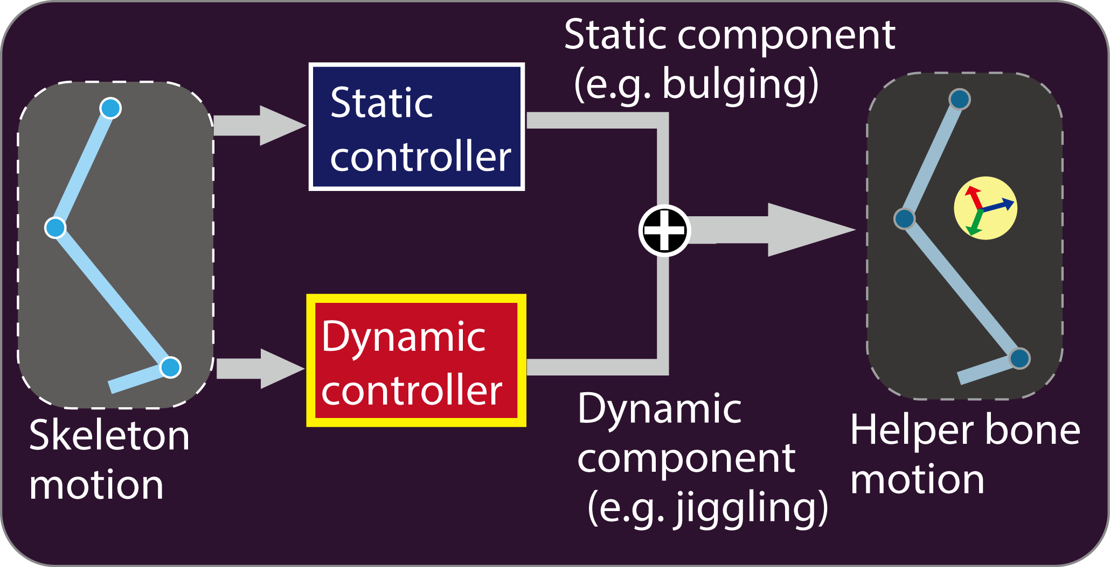
Helper Bone Controller
Polynomial function
[Mukai 2015]
SSM of LTI
Notes:
Our helper bone controller consists of two sub-controllers. The static controller computes the mapping from skeleton pose to helper bone pose. This controller is constructed as a polynomial function using a least-square fitting on the example data. The dynamic controller gives the secondary deformation such as jiggling. We assume the dynamics of helper bone is modeled as a state-space model of linear time-invariant system. Both static and dynamic controllers are represented by simple matrix-vector product, so they can be easily implemented and efficiently computed.

Slide 8
Related Dynamic Skinning Methods
Skeleton-driven elastic
simulation [Park 2006]
Kinodynamic skinning
[Angelidis 2007]
Dyna [Pons-Moll 2015]
DMPL [Loper 2015]
Elastic material param-
eter learning [Shi 2008]
Position-based dynamics
[Rumann 2015]
Pose-space subspace
dynamics [Xu 2016]
Notes:
Here we compare our method with related work. Most existing methods use a sophisticated runtime algorithm for providing great quality of skin deformation. In contrast, our method extends well-known helper bone rig to achieve efficient computation and high-compatibility with standard workflow.

Slide 9
Building Helper Bone Controller
Notes:
Next I will explain how to build bone controller.

Slide 10
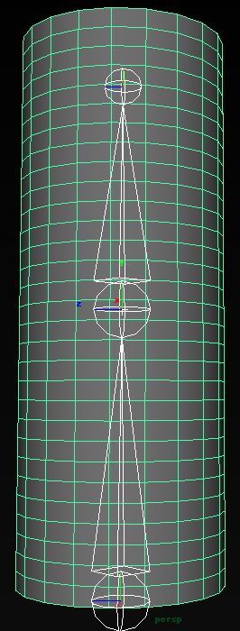
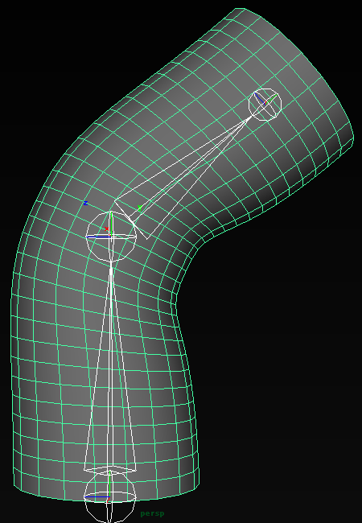
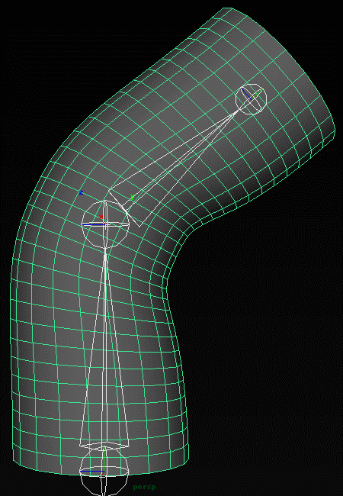
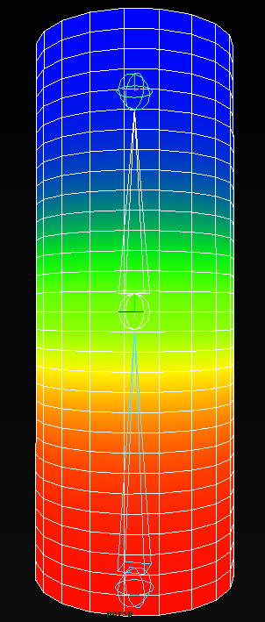
Authoring System
Input
Example skeleton animation
Example shape animation
Number of helper bones
Output
Helper bone controller
Skinning weight
Approximation criterion
Squared reconstruction error of vertex position
・・・
Notes:
The inputs of our authoring system are example skeleton animation, corresponding shape animation, and the number of helper bones. By learning these examples, we obtain the helper bone controller and the optimal skinning weights. Our method solves several least-square problems to minimize the approximation error of vertex position.

Slide 11
Example-based Controller Building
Skinning decomposition
[Mukai 2015, Le 2012]
Example skin
& skeleton
animation
Skin weights
& Helper bone
transformation
- Static controller (muscle bulging)
- Dynamic controller (jiggling)
&
[Mukai 2015]
Notes:
First, we solve a modified version of skinning decomposition problem to obtain the optimal skinning weights and helper bone transformations at each frame. Next, we build a static controller as a polynomial function using least-square fitting on the estimated helper bone transformations. Finally, the residual between the example and output of the static controller is approximated by a dynamic controller using system identification method. In this talk, we will focus on the details of dynamic controller. Please see our papers for the details of the skinning decomposition and the static controller.

Slide 12
Dynamic Control with LTI System
Internal state （unknown）
e.g. kinetic energy, inertia force
Linear Time-Invariant system
（unknown）
Input
(skeleton motion)
Output
(helper bone motion)
Notes:
Our dynamic controller is represented as a linear time-invariant system, or LTI. This system transfers the input, skeleton motion, to the output, dynamic helper bone motion, with a feedback control. The feedback signal is called internal state, which is a minimum subset of accumulated information of skeleton and helper bone motions. Roughly speaking, it could be interpreted as a reduced representation of internal dynamics of helper bone, such as kinetic energy and inertia force.

Slide 13
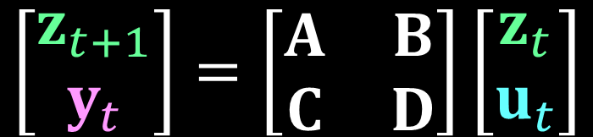
State-Space Model of LTI System
LTI
Internal state
at next time step
Internal state
$$\left[\begin{matrix}z_{t+1} \\ y_{t}\end{matrix}\right]=\left[\begin{matrix}A & B \\ C & D\end{matrix}\right]\left[\begin{matrix}z_{t} \\ u_{t}\end{matrix}\right]$$
Helper bone motion
System
matrix
Skeleton motion
Notes:
Typically, the LTI system is represented by a state-space model formulated as this simple matrix-vector product. The goal of the system identification is to estimate the unknown internal state Z and the system matrix, A , B, C and D, using given sequence of skeleton motion U and helper bone motion Y.

Slide 14


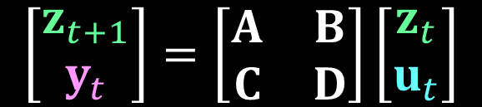


System Identification
$$\left[\begin{matrix}z_{t+1} \\ y_{t}\end{matrix}\right]=\left[\begin{matrix}A & B \\ C & D\end{matrix}\right]\left[\begin{matrix}z_{t} \\ u_{t}\end{matrix}\right]$$
Cancel the linear effect of
skeleton motion from helper bone motion
TSVD$\left( \right)→Z$
$$U^{†}$$
$$Y$$
Null-space projection of
Hankel matrix of skeleton
motion
Hankel matrix of
helper bone motion
Truncated
singular value
decomposition
Internal state
&
System matrix
$$U^{†}U=0$$
Notes:
Here, I will briefly explain the basic idea of a system identification, although we actually use an advanced method for robust and accurate estimation. First, we compose a Hankel matrix from helper bone transformation. Next, we compose another Hankel matrix from skeleton motion and computes its null-space projection, for cancelling the linear effect of skeleton motion from the helper bone. Finally, we estimate the internal state and the system matrix via truncated SVD of this matrix product.
In the traditional system identification, the dimensionality of the state-space model is determined based on the singular values. However, we want to minimize the dimensionality for reducing the computational cost. The naïve method is to truncate insignificant singular values, but it often decreases the estimation accuracy.

Slide 15







Dimensionality Reduction of Internal State
$$min \text{dim}\left(Z\right)$$
$$=$$
$$\left[\begin{matrix}z_{t+1} \\ y_{t}\end{matrix}\right]=\left[\begin{matrix}A & B \\ C & D\end{matrix}\right]\left[\begin{matrix}z_{t} \\ u_{t}\end{matrix}\right]$$
$$min rank\left(U^{†}Y\right)$$
TSVD$\left(U^{†}Y\right)→Z$
$$\sim$$
$$\min{{\left|U^{†}Y\right|}_{}}$$
$$\text{N}$$
: Nuclear norm
Notes:
The important observation is, the dimensionality reduction is identical to a rank reduction of the matrix product U dagger Y, and this matrix often has sparsity. Even though the rank reduction problem is difficult to solve, an approximate solution can be efficiently obtained by minimizing its nuclear norm, according to the recent researches on sparse modeling.

Slide 16



N2SID: Nuclear Norm System IDentification
[Liu 2013]
Example helper
bone motion
$$\min{{\left|U^{†}Y\right|}_{}+β\sum_{t}{{\left|y_{t}−{\hat{y}}_{t}\right|}_{2}^{2}}}$$
$$\text{N}$$
$$y$$
Helper bone motion
minimizing nuclear norm
Relaxing rank reduction problem into nuclear norm minimization problem
User-specified precision of helper bone control
Notes:
There are some system identification methods based on the nuclear norm optimization. We experimentally found that N2SID is most robust and efficient. This method enables the control of tradeoff between the rank reduction and the estimation accuracy through the shrinkage parameter, denoted by Beta. In other words, N2SID reduces the size of state-space model given the user-specified control precision.

Slide 17
Algorithm Summary
Polynomial function
[Mukai 2015]
SSM
+
N2SID
Notes:
In summary, our technical contribution is the introduction of state-space model to the helper bone controllers for mapping the primary skeleton motion to the helper bone. We also use N2SID for automatically building a compact controller from examples.

Slide 18
Experimental Results
Notes:
Now I will demonstrate some experimental results.

Slide 19
Monster’s Leg Model
Maya muscle
Height = 200 cm
# of vertices = 663
# of muscles = 11
Joint DOF = 5
Training sequence of 4,000 frames
Notes:
Our first experiment uses a tutorial asset of Maya muscle for generating training data of 4000 frames. This monster’s leg model has skeleton and virtual muscles for driving the skin deformation.

Slide 20
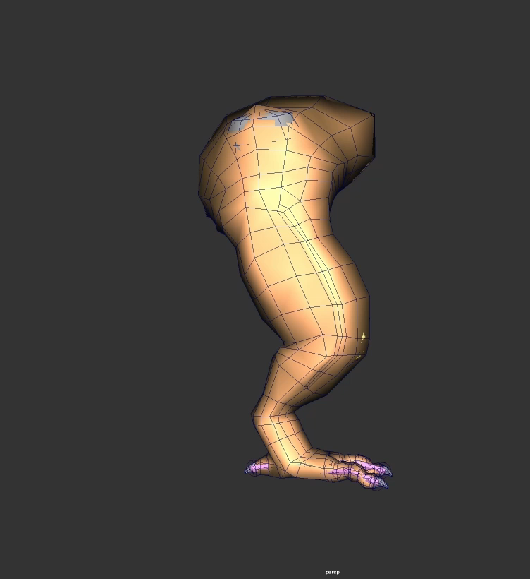
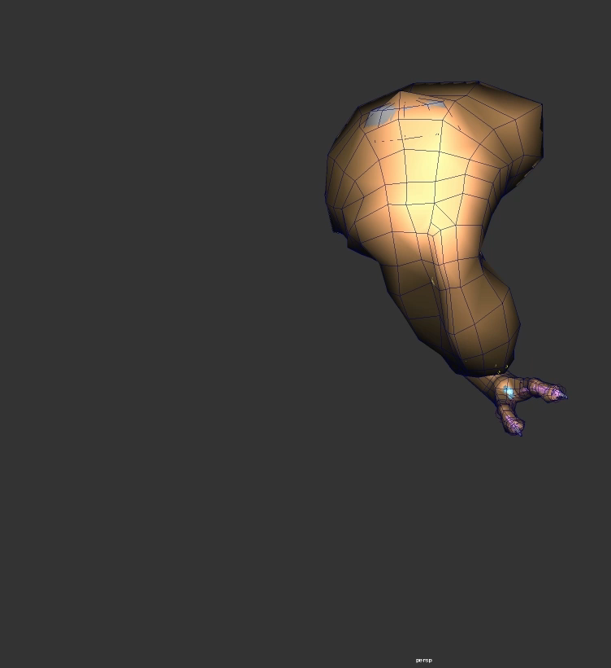
Sampling of Training Data
Spline interpolation
Freeze interpolation
Notes:
The training sequence was generated by interpolating randomly sampled key poses. We used two type of keyframe interpolation methods to cover a wide range of skin dynamics.

Slide 21
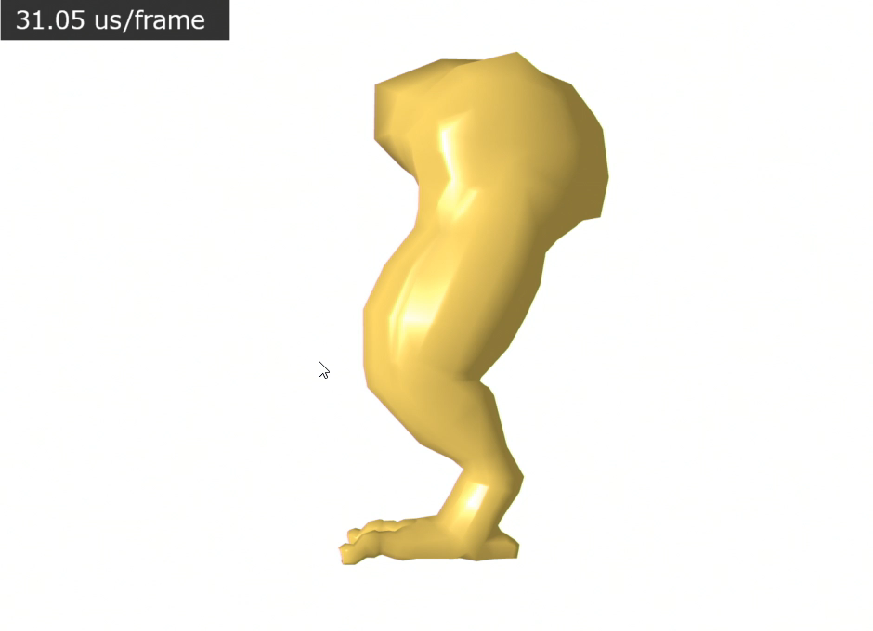
Runtime Rig with Four Helper Bones
Notes:
We built the runtime rig with 4 helper bones by learning the training sequence. Helper bones are indicated by arrow gizmos. According to the movement of primary skeleton, helper bones are procedurally controlled to generate the dynamic behavior. The execution time for all controllers is within 20 us per frame.

Slide 22
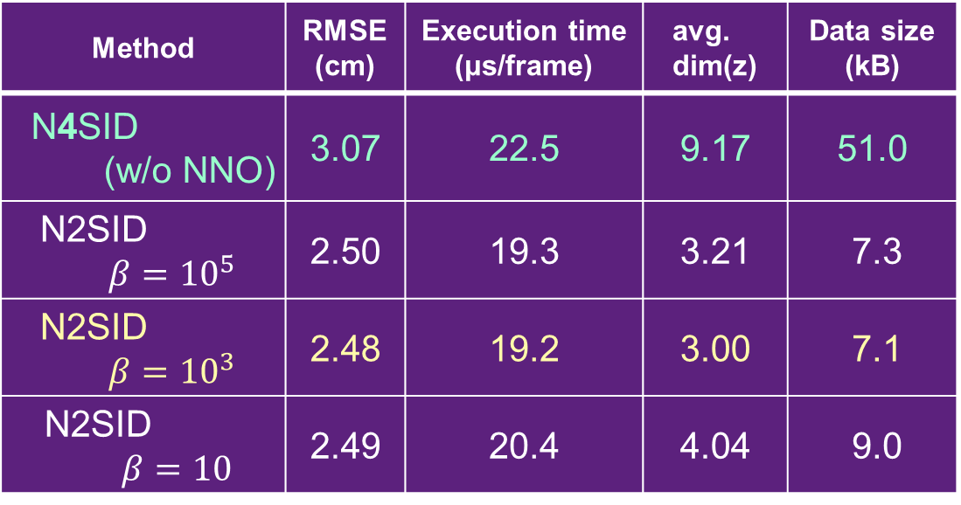

Performance Evaluation
Method | RMSE (cm) | Execution time (μs/frame) | avg. dim(z) | Data size (kB)
N4SID (w/o NNO) | 3.07 | 22.5 | 9.17 | 51.0
N2SID $$β={10}^{5}$$ | 2.50 | 19.3 | 3.21 | 7.3
N2SID $$β={10}^{3}$$ | 2.48 | 19.2 | 3.00 | 7.1
N2SID $$β=10$$ | 2.49 | 20.4 | 4.04 | 9.0
$$\min{{\left|U^{+}Y\right|}_{Ν}+β\sum_{t}{{\left|y_{t}−{\hat{y}}_{t}\right|}_{2}^{2}}}$$
Notes:
This table summarizes the results of performance evaluation. We compare against N4SID as baseline method, because this is the standard system identification without using nuclear norm optimization. Our method successfully reduces both execution time and data size while improving the approximation accuracy, independent of the the shrinkage parameter beta. This shows the superior performance of nuclear norm optimization than the naïve SVD.

Slide 23
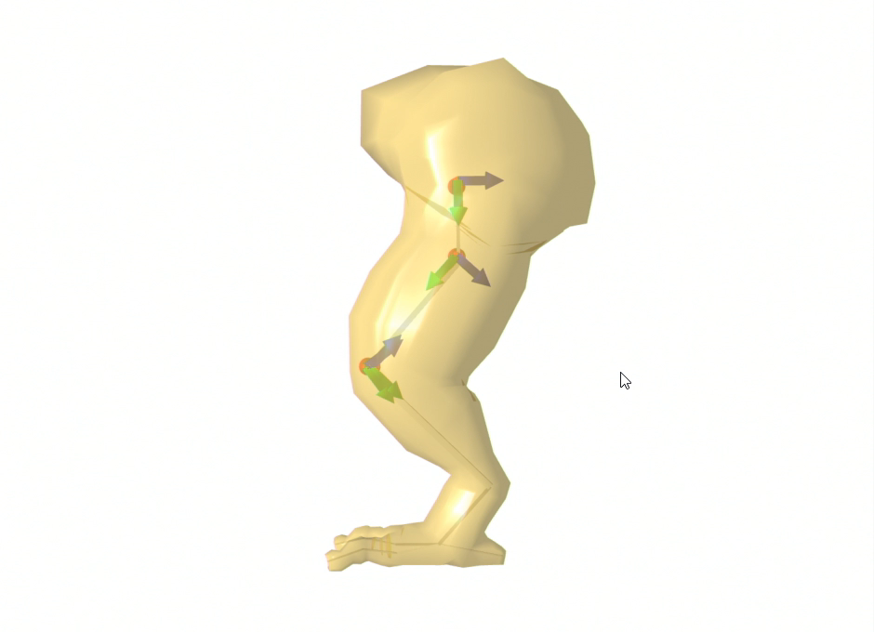
Autoregressive Model-based Control
[de Aguiar 2010, Pons-Moll 2015, Loper 2015]
Notes:
We also implemented an autoregressive controller used in existing dynamic skinning, and in real-time clothing. As you see, this existing approach results in the slow convergence and lacks the dynamic behavior. Why our approach provides better results? Because the state-space model is a generalization of the autoregressive model, and integrating with N2SID more precisely capture the dynamics of helper bone with a minimal representation.

Slide 24
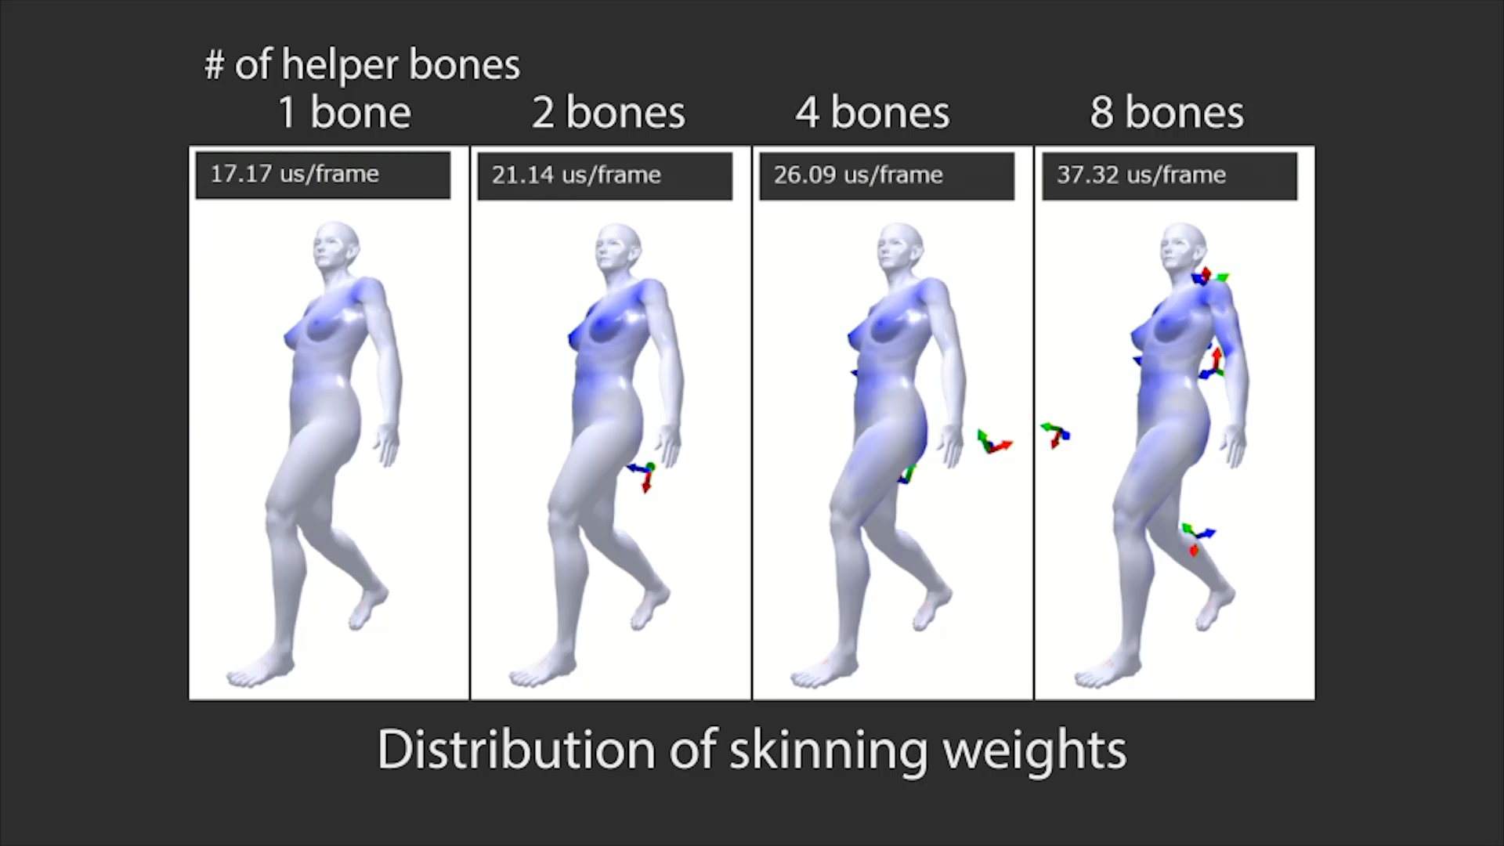
Approximation of Human-like Muscle Rig http://www.behind-universe.org/
Notes:
We applied our method to a muscle-based character model. The training and test sequences are the same dancing motion of 6000 frames. The blue color visualizes the influence of helper bones, in other words, darker blue indicates larger skinning weight. You can find the soft body parts are well covered by the helper bones. This heat map indicates the reconstruction error of vertex position. The error is observed mainly around the soft parts of the body, and its magnitude is within 0.3 cm.

Slide 25
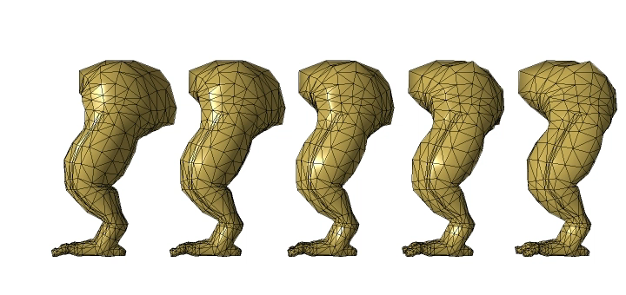

Exaggeration of Dynamic Deformation
$$\left[\begin{matrix}z_{t+1} \\ y_{t}\end{matrix}\right]=\left[\begin{matrix}A & B \\ C & D\end{matrix}\right]\left[\begin{matrix}z_{t} \\ u_{t}\end{matrix}\right]$$
x 0.5
x 1.0
x 2.0
x 4.0
x 6.0
Notes:
Our helper bone controller allows the exaggeration of dynamic movement by simply scaling the control signal. Excessive scaling causes collapse of skin, but this simple technique is practical for creating a variety of skin stiffness even from a single data set.

Slide 26
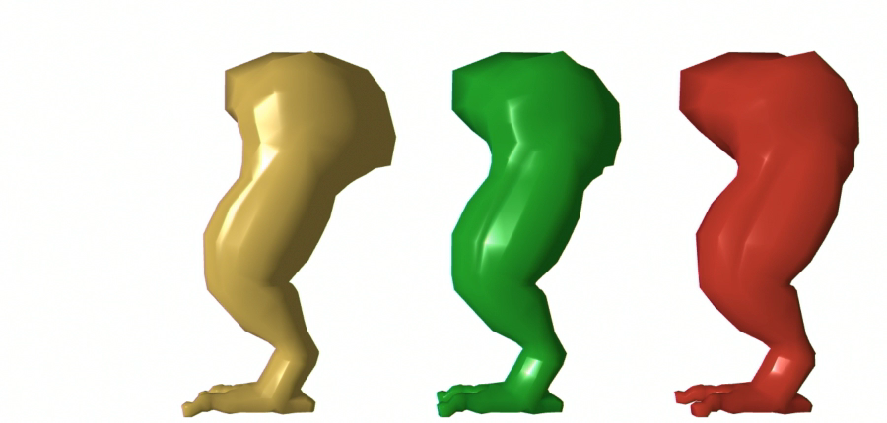
Level of Deformation Details
Dynamic + Static
（~20 μs）
Static only
(~5 μs)
No control
Notes:
Our another application is the LOD control of skin deformation. We can adaptively control these three LOD models by switching on and off the static and dynamic controllers.

Slide 27
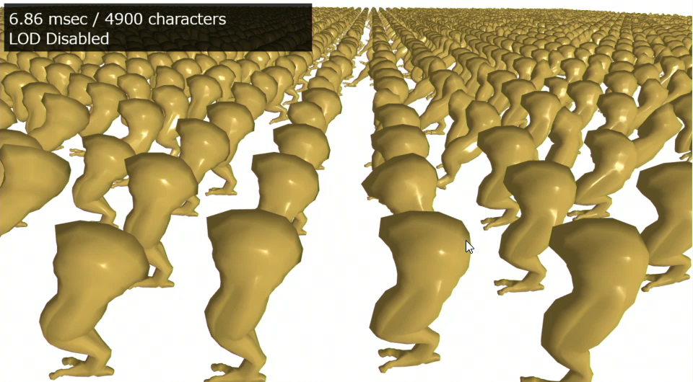
Level of Deformation Details
Notes:
This scene includes about 5,000 monster’s leg models. Three LOD models are adaptively selected depending on the distance from the viewpoint. Our LOD control reduces the computational cost of the dynamic skinning for such a massive size of crowd scene.

Slide 28
Pros and Cons
Pros
Plausible dynamic skinning
Simple implementation of state-space model
Efficient computation via nuclear norm optimization
Cons
Detailed deformation (e.g. wrinkles)
External force (gravity, contact, self-collision)
Physical validity (volume preservation)
Notes:
We here summarize the pros and cons. Our method generates plausible dynamic skin deformation with efficient runtime computation, thanks to the simple representation of state-space model and nuclear norm optimization. On the other hand, our method cannot synthesize detailed deformation such as wrinkles. External forces such as gravity and contact force are not considered. Also, our example-based, kinematic controller does not guarantee the physical validity such as volume preservation. In spite of these limitations, we believe that our method is useful and practical because there is only limited computational budget for skinning in commercial products.

Slide 29
Conclusion
Helper bone rig
Fully compatible with standard workflow
State-space model
Simple and Robust （via Eigen analysis）
Nuclear norm optimization
Efficient computation（~20 μs）
Small memory footprint (~10 kB)
Future work
Locally-adaptive rigging
Non-linear skinning models
Acknowledgements
SIGGRAPH reviewers
TAISO, Renpoo (www.behind-universe.org/)
JSPS-KAKENHI 15K16110, 15H02704
Notes:
In conclusion, we have proposed the helper bone rig for generating example-based dynamic behavior with compact controllers. As a future work, we should explore more efficient, adaptive rigging technique like modular rigging system because each helper bone is driven by all primary bones even if they are spatially distant. Another future direction is an extension to non-linear skinning models such as spherical blend skinning and dual quaternion skinning. The main challenge is a non-linear skinning decomposition, which is an open question.

